Slide 1
OBJECT TRACKING SYSTEM USING DEEPSORT
Vennela Madamshetty 700736655

Slide 2
Motivation
The sheer difficulty of tracking objects/persons in public places using regular camera surveillance is becoming a need of academic, public/industrial markets in the form of real-time monitoring of human activities in restricted environments, monitoring uncertain events, crowd counting, and pedestrian traffic management using recent advancements in information technology.
As the research community has become more interested in these systems, the problems and technological issues have grown.
Moving/non-moving item detection, multi-person tracking, categorization, and sophisticated human motion analysis are some of these difficulties.

Slide 3
Objectives
To find appropriate and high-performance detection models for real-time object recognition and tracking in public surveillance.
Detection models are used to classify the objects that have been selected.
Surveillance of discovered items, including tracking and monitoring their motions.

Slide 4
Related Work
Object detection is the process of identifying and locating real-world objects in images or videos.
Approaches to object detection include deep learning, Viola-Jones, feature-based, and SVM with HOG.
Fast R-CNN, SSD, and Retina-Net are popular deep-learning models for object detection.
Object tracking involves following an object across frames in a video.
Approaches to object tracking include Mean Shift and Optical Flow.
Mean Shift is a clustering algorithm used for object tracking that doesn't require an optimal "K" value.
Optical Flow tracks an object by examining motion vectors in consecutive frames.

Slide 5
Problem Statement
To reduce human inspection over surveillance.
To increase the efficiency and accuracy of surveillance systems.
To properly classify and identify an object in the surveillance system.

Slide 6
Proposed Solution
Preprocess the input video frames to remove noise, blur, and other artifacts that may interfere with object detection and tracking.
Use a deep learning model such as YOLO or SSD to detect objects in each video frame.
Feed the detected objects into a deep sort algorithm to associate each object with a unique ID and track its movement across frames.
Apply Kalman filters and data association algorithms to improve tracking accuracy and handle occlusions and missed detections.
Use a clustering algorithm to group objects that are likely to belong to the same track and remove false positives.
Visualize the tracking results in real-time or post-processing to evaluate the performance of the system and make any necessary adjustments.

Slide 7
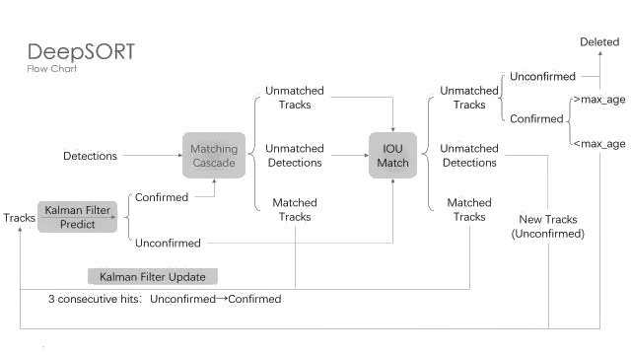
Flow Of DeepSORT

Slide 8
Results
Objects with labeling.
Tracking Object till the object leaves the frame.
The live processed frames are displayed as FPS(Frames Per Sec).

Slide 9
Outputs

Slide 10
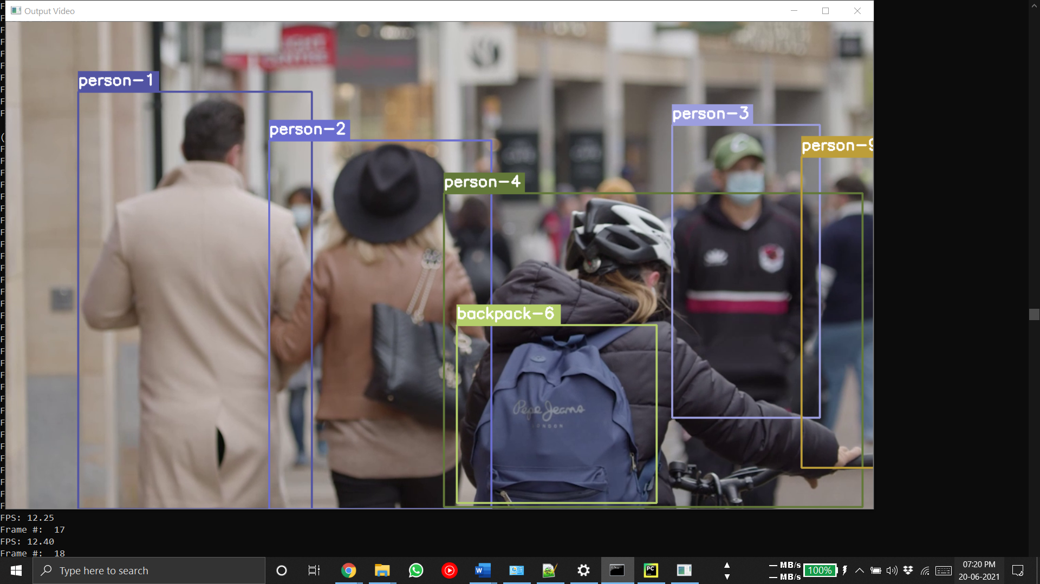

Slide 11
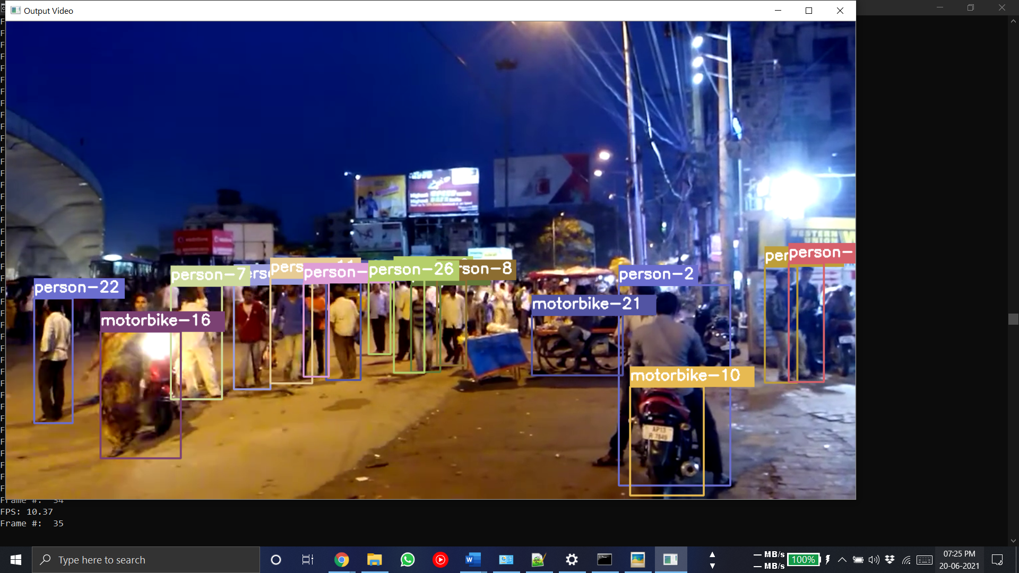

Slide 12
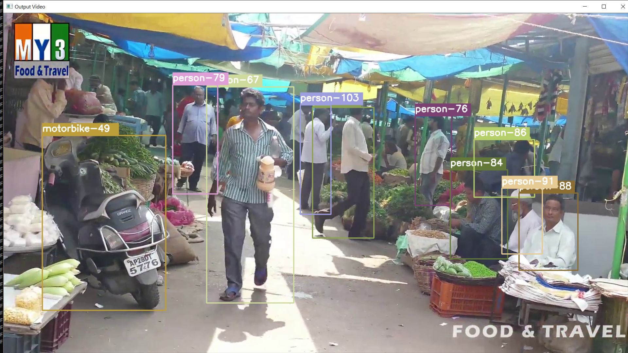
Demonstration

Slide 13
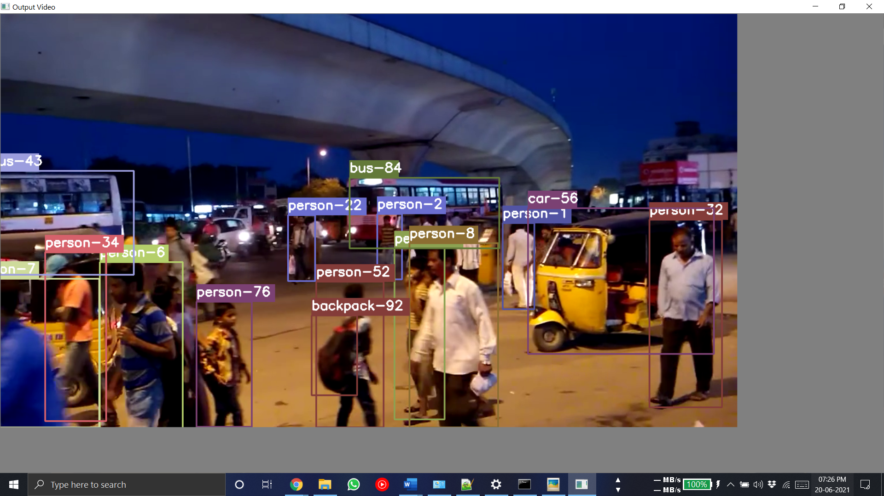

Slide 14
THANK YOU

